Slide 1



Chapter 18
Host Configuration: DHCP
Copyright © The McGraw-Hill Companies, Inc. Permission required for reproduction or display.

Slide 2
OBJECTIVES:
To give the reasons why we need host configuration.
To give a historical background of two protocols used for host configuration in the past.
To define DHCP as the current Dynamic Host Configuration Protocol.
To discuss DHCP operation when the client and server are on the same network or on different networks.
To show how DHCP uses two well-known ports of UDP to achieve configuration.
To discuss the states the clients go through to lease an IP address from a DHCP server

Slide 3
Chapter Outline
18.1 Introduction
18.2 DHCP Operation
18.3 Configuration

Slide 4
18-1 INTRODUCTION
Each computer that uses the TCP/IP protocol suite needs to know its IP address. If the computer uses classless addressing or is a member of a subnet, it also needs to know its subnet mask. Most computers today need two other pieces of information: the address of a default router to be able to communicate with other networks and the address of a name server to be able to use names instead of addresses as we will see in the next chapter. In other words, four pieces of information are normally needed.

Slide 5
Topics Discussed in the Section
Previous Protocols
RARP
BOOTP
DHCP

Slide 6
18-2 DHCP OPERATION
The DHCP client and server can either be on the same network or on different networks. Let us discuss each situation separately.

Slide 7
Topics Discussed in the Section
Same Network
Different Networks
UDP Ports
Using TFTP
Error Control
Packet Format

Slide 8
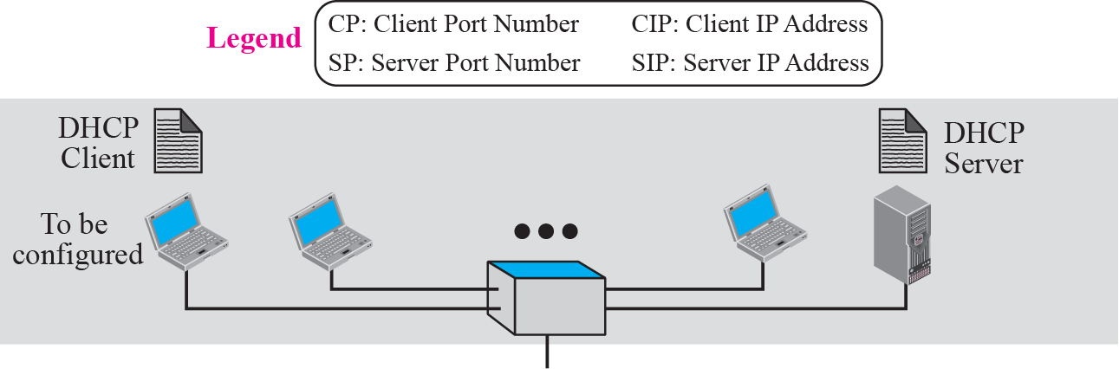
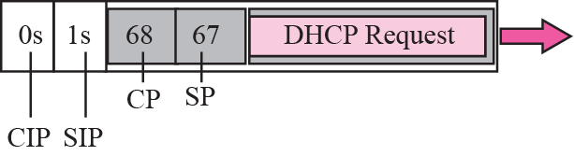
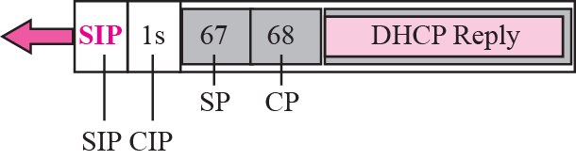
Figure 18.1 Client and server on the same network

Slide 9
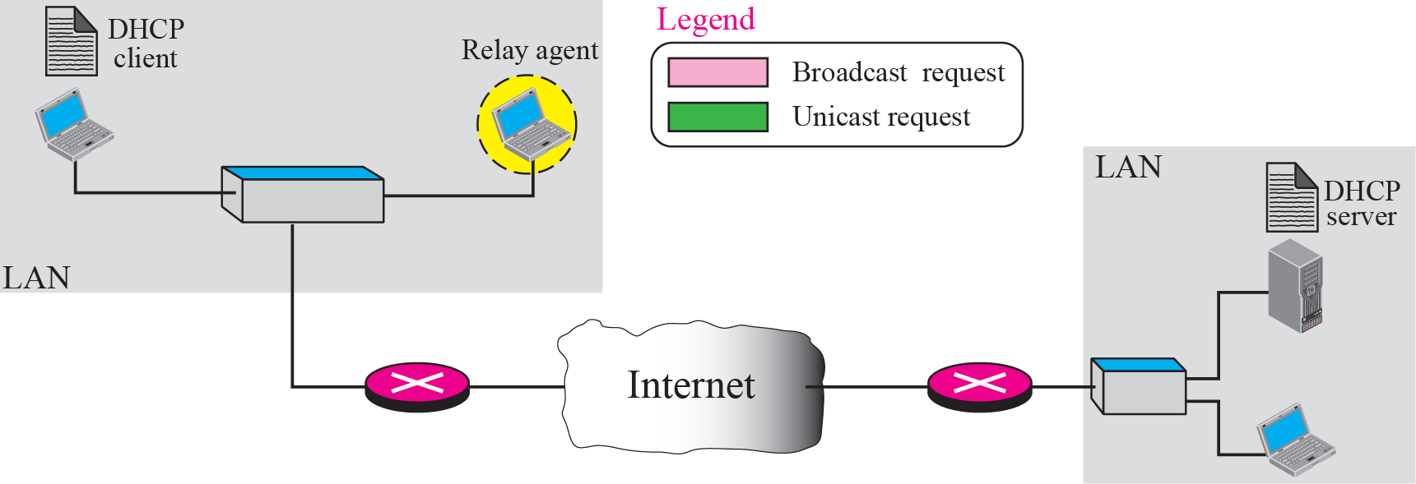
Figure 18.2 Client and server on two different networks

Slide 10
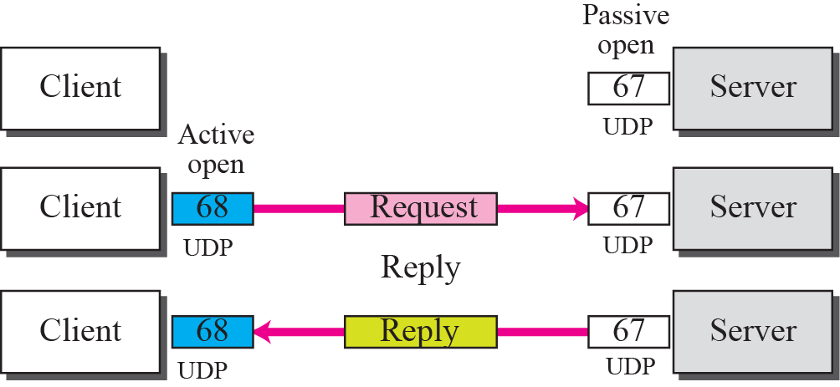
Figure 18.3 Use of UDP ports

Slide 11
Using TFTP
Error Control

Slide 12
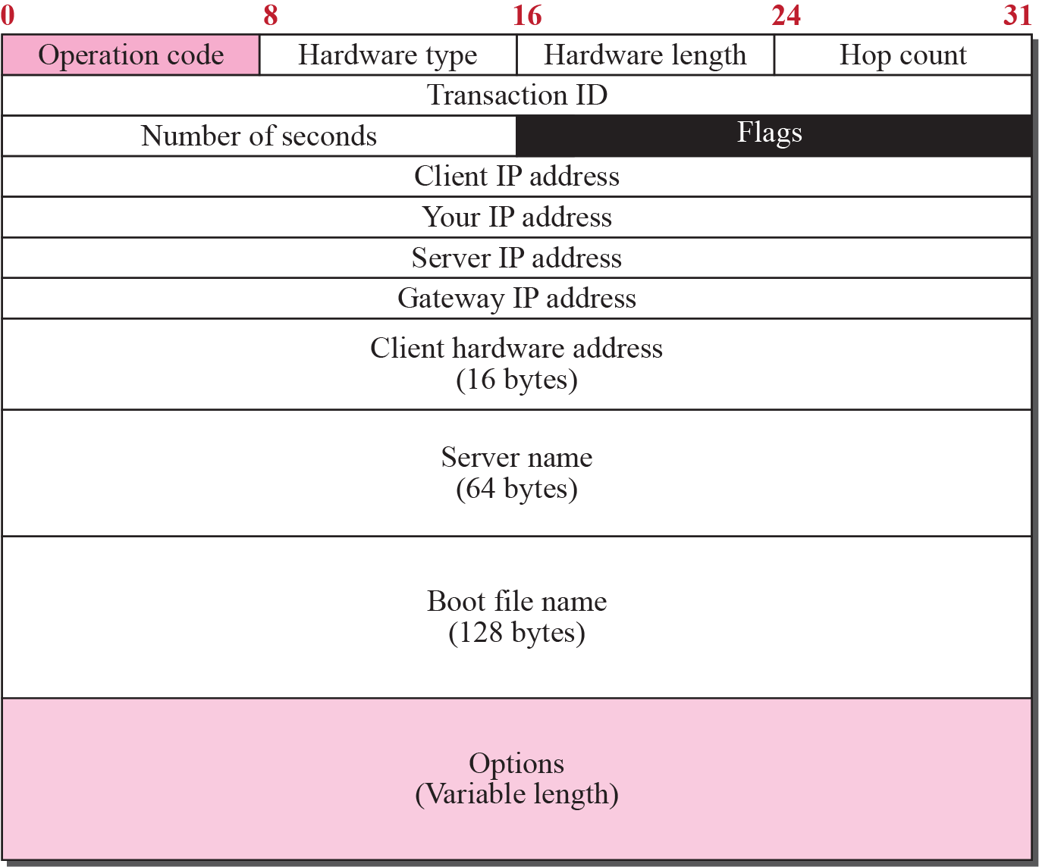
Figure 18.4 DHCP packet format

Slide 13
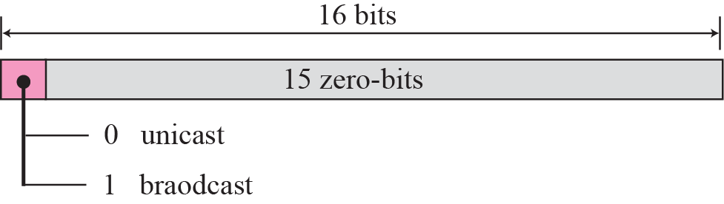
Figure 18.5 Flag format

Slide 14
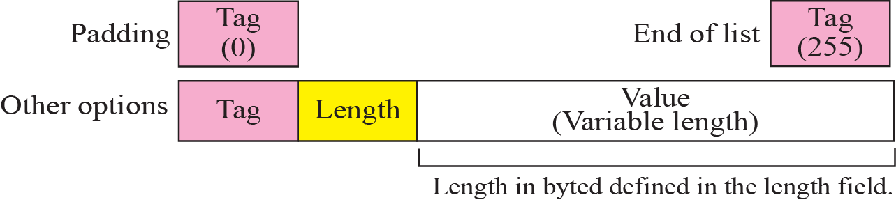
Figure 18.6 Option format

Slide 15
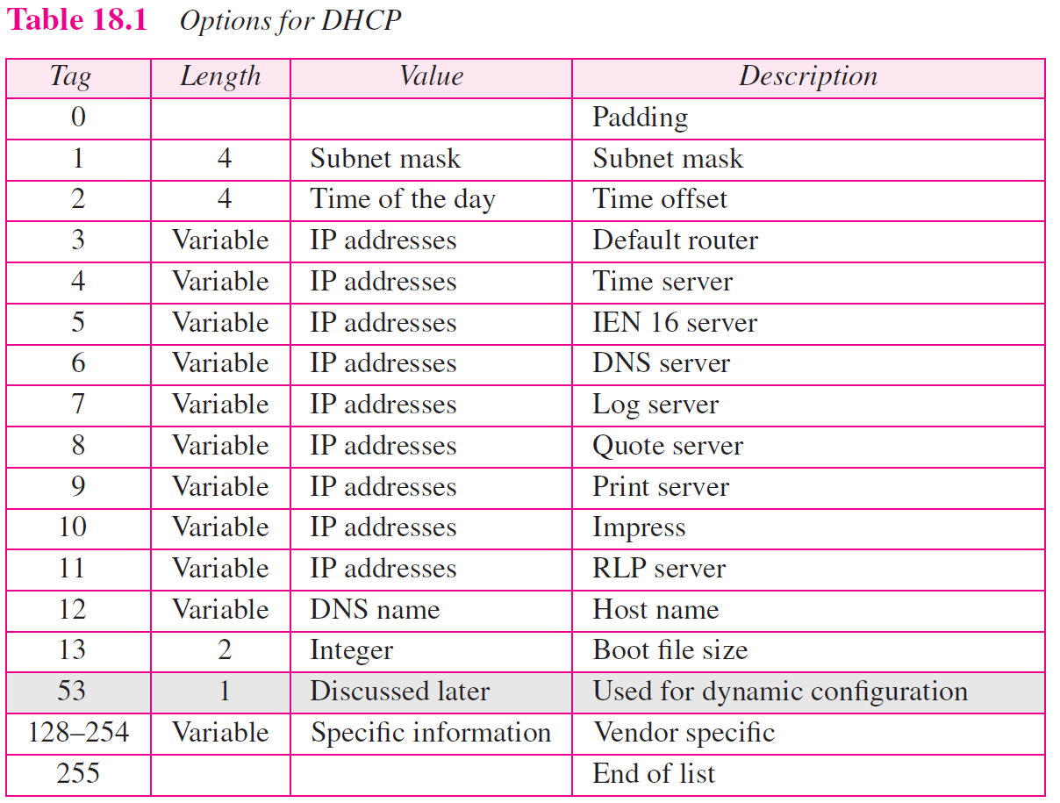

Slide 16
18-3 CONFIGURATION
The DHCP has been devised to provide static and dynamic address allocation.

Slide 17
Topics Discussed in the Section
Static Address Allocation
Dynamic Address Allocation
Transition States
Other Issues
Exchanging Messages

Slide 18
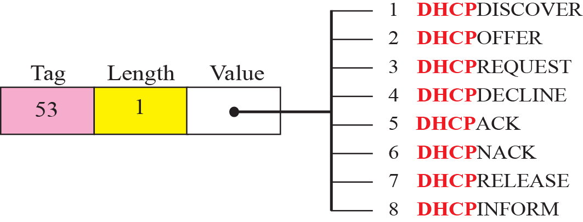
Figure 18.7 Option with tag 53

Slide 19
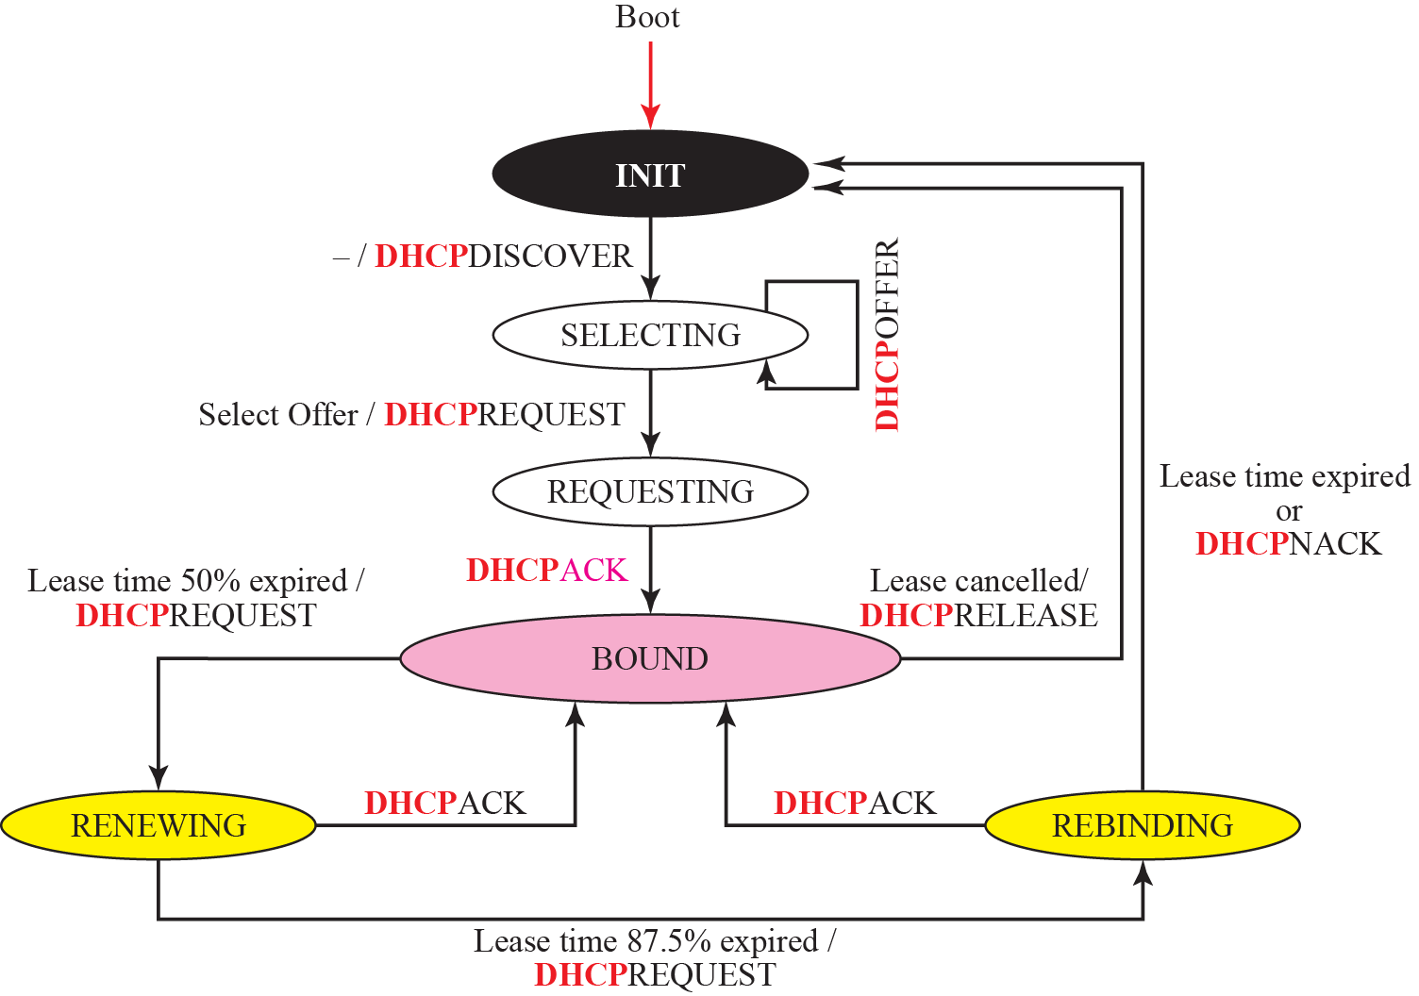
Figure 18.8 DHCP client transition diagram

Slide 20
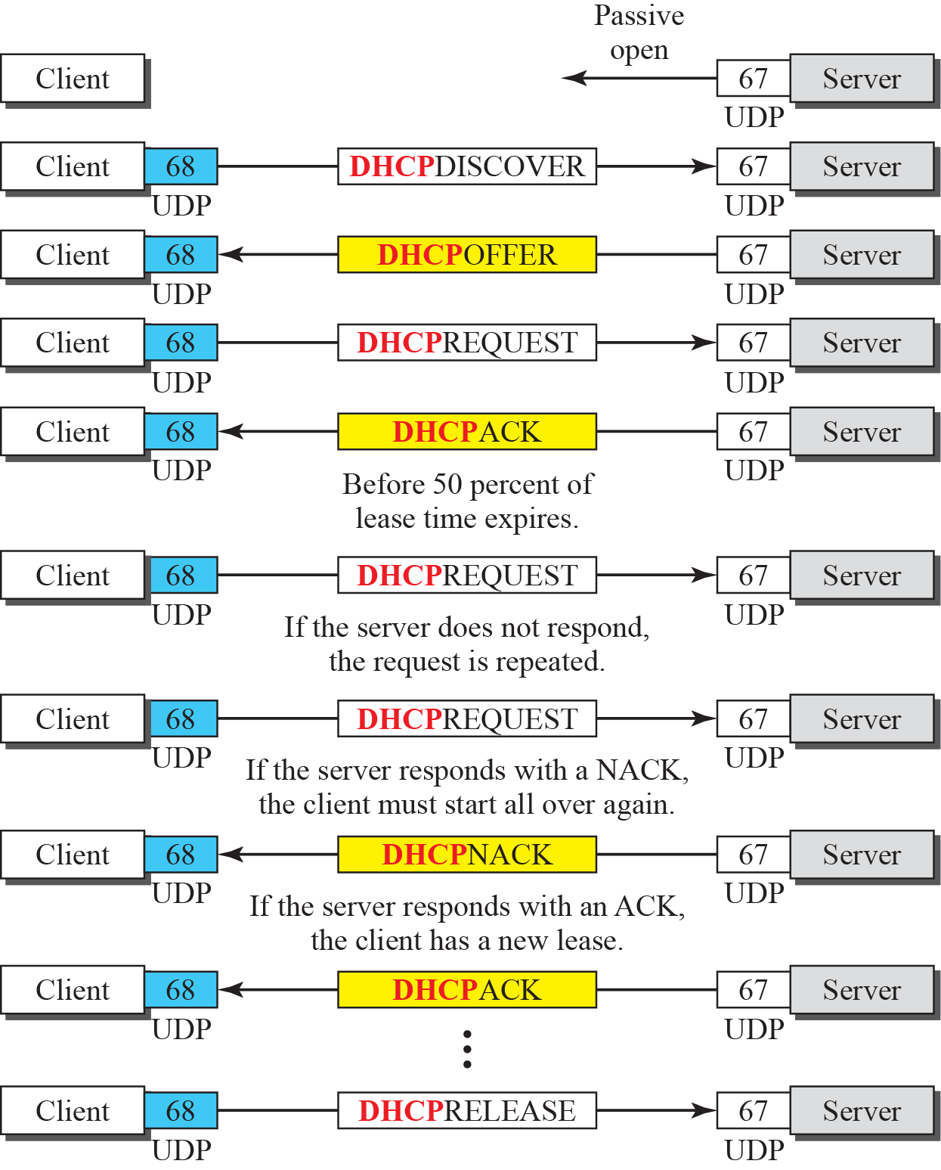
Figure 18.9 Exchanging messages

